Slide 1
rec11: virtual memory!

Slide 2
Motivation
Need more memory for multiple programs than we have in physical memory
Prevent programs from reading/writing to each other’s data
Multiple programs try to store something at the same address
Terms:
Page: block of memory (typically 4KB, or 4096 bytes)
Virtual address: visible to applications to access memory
Physical address: address on physical hardware of memory
Address space: set of memory addresses that are available to a program
Can have virtual address space and physical address space
Page table: data structure for mapping virtual page to physical page

Slide 3
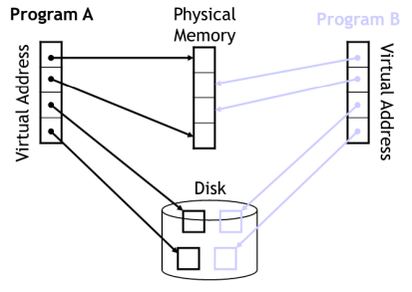
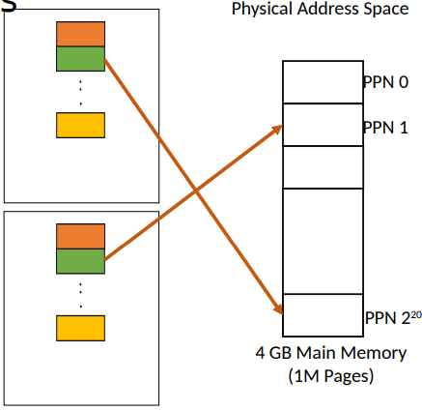
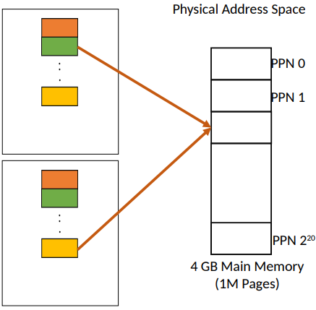
Mapping from VA to PA
Homonym:
same virtual address in different applications map to different physical addresses
Synonym:
different virtual addresses in different applications map to same physical addresses
Multiple programs can behave as if they have access to all of memory

Slide 4
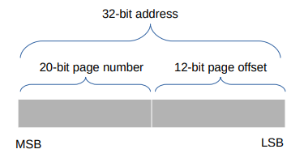
Page translation
Suppose page size is 4KB
Given a 32 bit address, which bits will represent page number and page offset?
Need 12 bits to indicate page offset (memory location within page)
Remaining 20 bits indicate page number
Equations:
Page_num = address // page_size
Page_offset = address % page_size

Slide 5
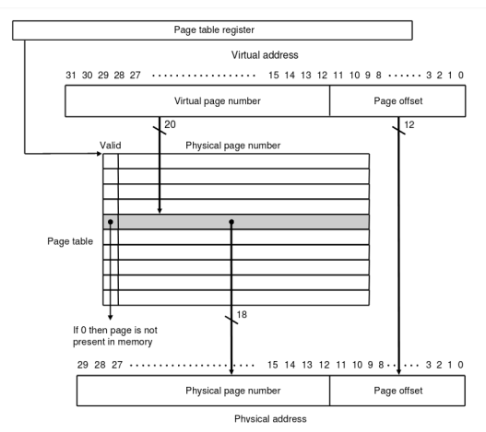
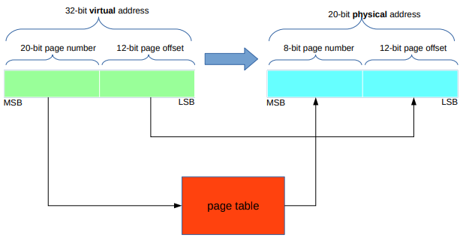
Page translation

Slide 6
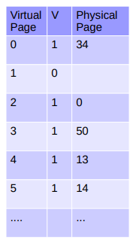
Page Table
Created and managed by OS
Each process (instance of a program) has its own page table
To get a physical address
Page offset = virtual address % page size
Virtual page = virtual address // page size
Physical page → from page table look up with virtual address
Physical address = ( physical page * page size ) + page offset
Valid bit
0 if there is not a physical page assigned to correspond to the virtual page
1 is there is
Where do things that don’t fit in main memory go?
Disk

Slide 7
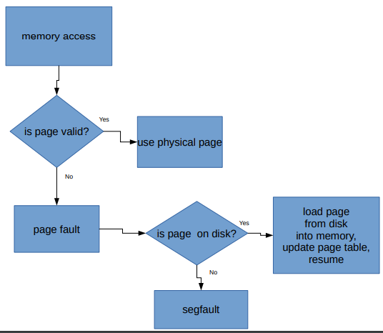

Slide 8
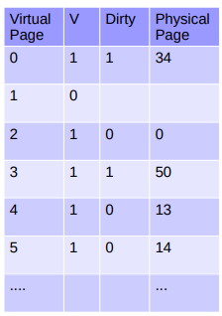
Swapping
What happens if there isn’t space in physical memory to swap pages into?
Evict pages from memory and swap to disk!
What if pages have been modified since they’ve been retrieved from disk?
Each entry in page table has a dirty bit
Initially set to 0
When program writes to the page, dirty bit is set to 1
If dirty bit is 1, the page is written to disk when evicted
What does this sound like?
Write back cache policy!

Slide 9
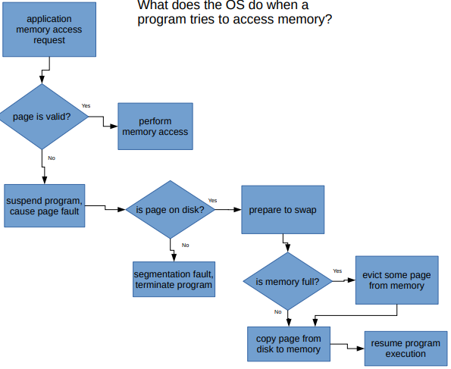

Slide 11
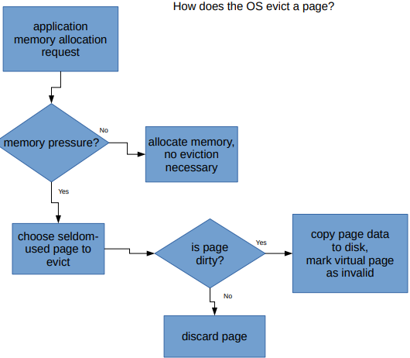

Slide 12
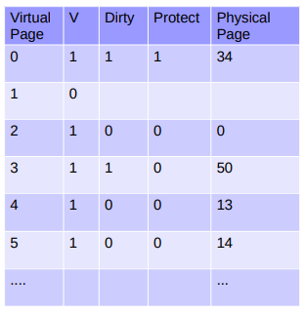
Managing shared address space
OS and applications may share physical address space
We don’t want an application to be able to change OS data!
Protect bit
When 1, pages cannot be written to

Slide 13
rec11
All set for rec11!
(oh how far we’ve come from rec1… the good old days of number systems)
If you want to see how a page table is modified by a program, refer to slides 39-45 of the virtual memory lecture slides.
If you finish early, work on fixing your Project 1! Project 2 will build on this and you don’t want to be double penalized. Here to help :)

